Slide 1

Analyzing-ARP-traffic-using-Packet-Tracer
COURSE WORK

Slide 2


What will we talk about?
Introduction to Computer Networks
Network Protocols
Address Resolution Protocol (ARP)
Analyzing ARP Traffic Using Packet Tracer
Result

Slide 3
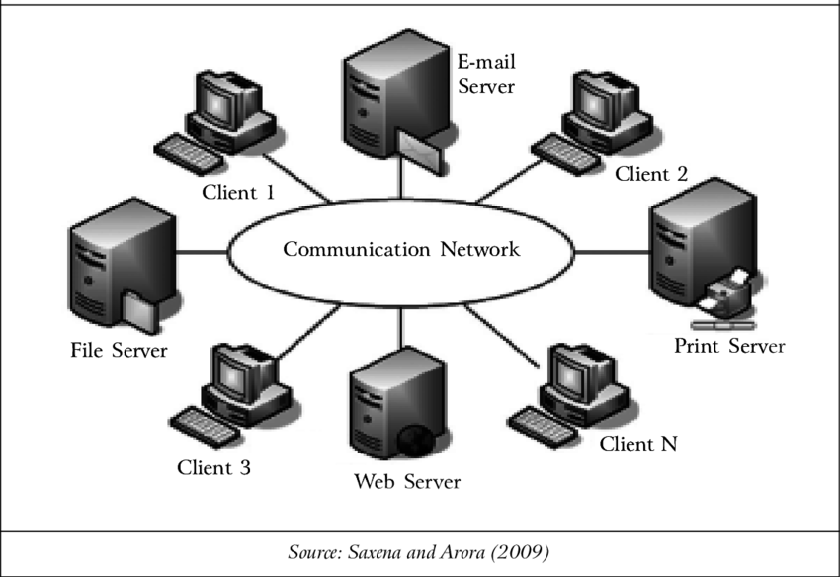
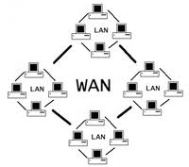
Computer Networks
Local Area Network (LAN)
Wide Area Network (WAN)
Metropolitan Area Network (MAN)
Wireless Networks
Nodes
Links
Switches
Routers

Slide 4
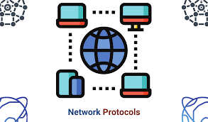
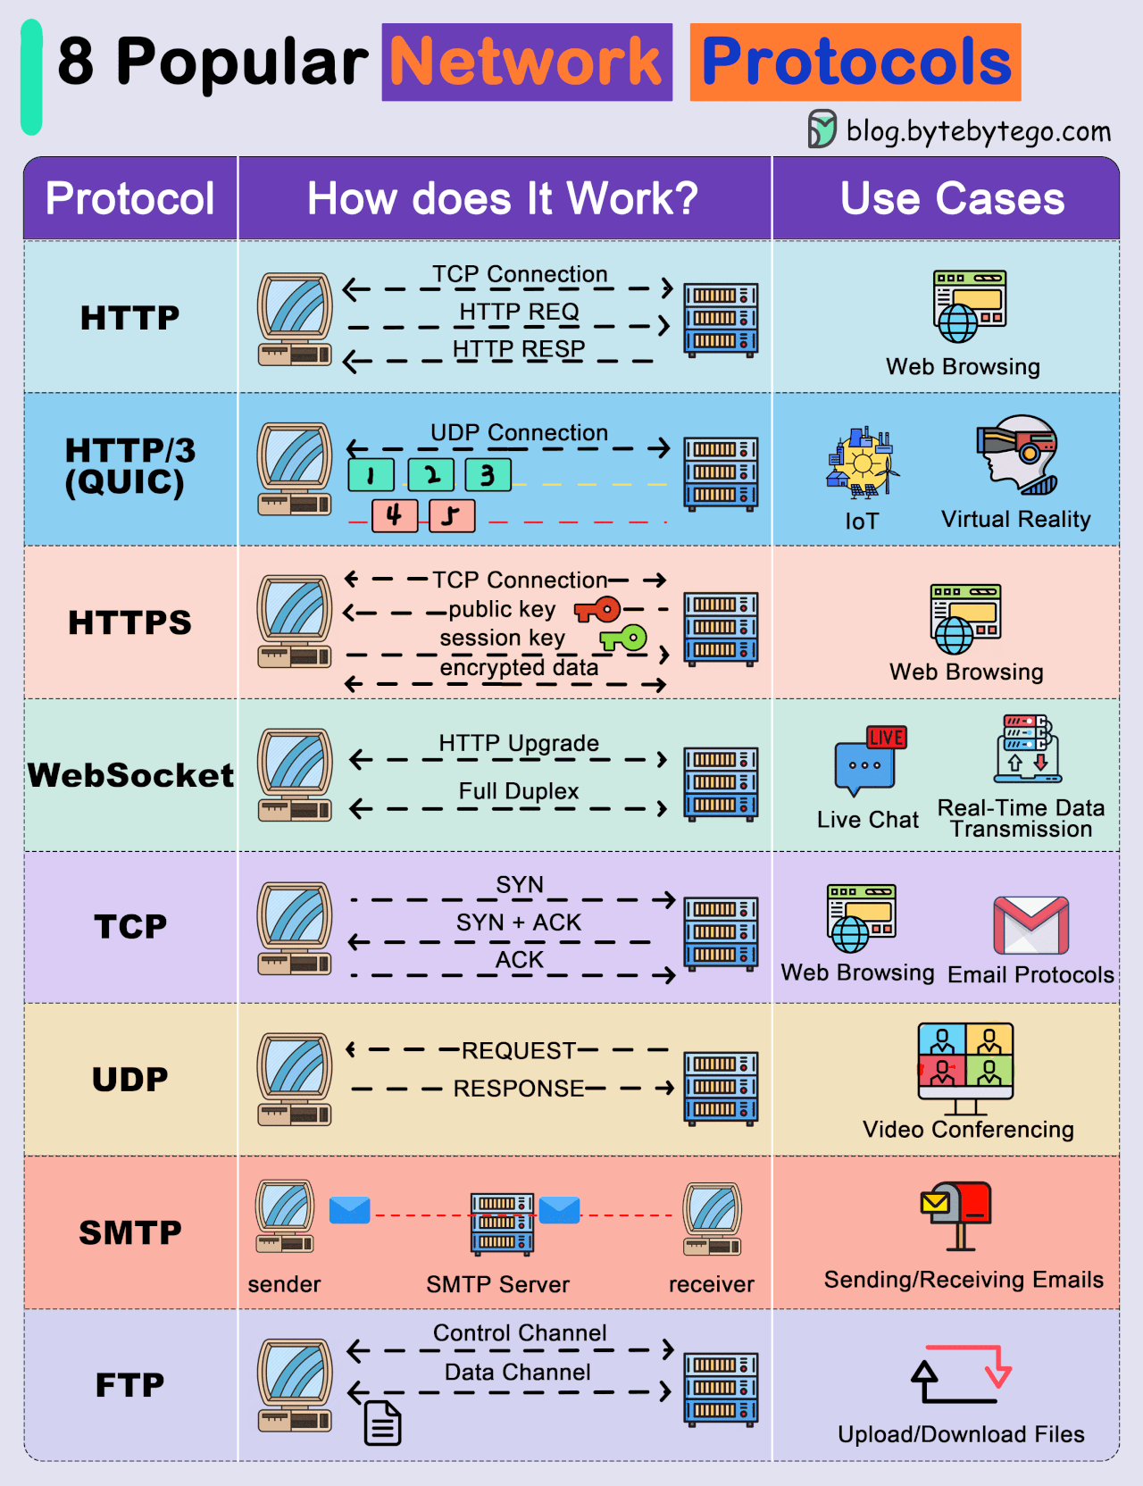
Network Protocols
Definition and Purpose
Examples of Network Protocols
TCP/IP
Ethernet
Address Resolution Protocol (ARP)

Slide 5
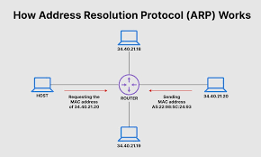
Address Resolution Protocol (ARP)
Why is ARP necessary?
How ARP works
ARP Table
ARP Cache Poisoning and ARP Spoofing

Slide 6
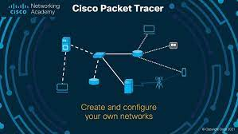
Analyzing ARP Traffic Using Packet Tracer
Introduction to Packet Tracer
Features and Capabilities
How to Use Packet Tracer for Network Analysis
Setting up a Network Topology in Packet Tracer

Slide 7

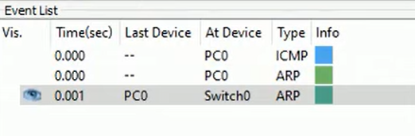
Analyzing

Slide 8

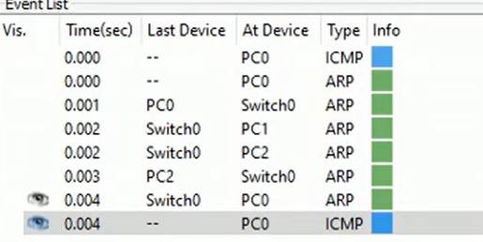
Analyzing

Slide 9

Testing out
So, let’s jump in Packet Tracer☺

Slide 10

Conclusion
THANKS FOR ATTENTION!

